Slide 1
Price of New York Airbnb Rentals
Raghav Arora, Kimberly Bhunu, Dom Demas, Maddie Willett
The Athletes: Cal Poly MSBA
3/15/23

Slide 2
Problem Statement
Which variables best predict the price of New York Airbnb rentals?

Slide 3
Preview of Results: Best Model
Model | Recipe | MSE
Linear | 3 | 66970.16
KNN | 3 | 65727.35
Random Forest | 3 | 65374.61
The Random Forest model with Recipe 3 best predicts the price of Airbnb rentals!

Slide 4
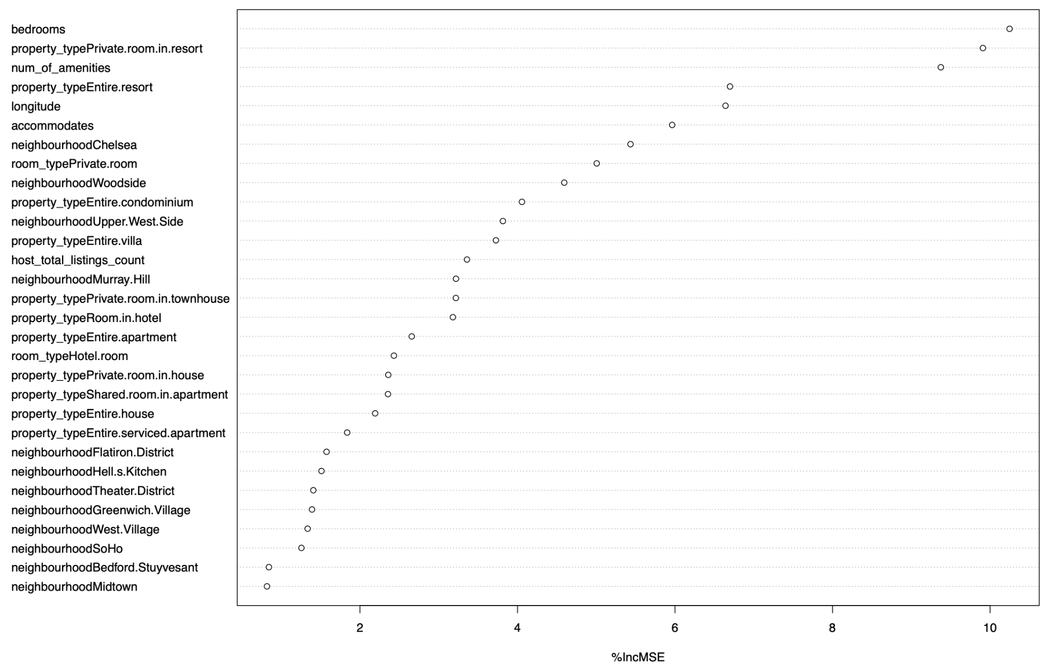
Preview of Results: Best Variables

Slide 5
Background Review
What has been done?
Analyzed Airbnb data for multiple different cities
Performed predictive modeling
OLS Regression
XGBoost
Revealed best predictors
Improvements
Multicollinearity
Overfitting
Notes:
studies

Slide 6
Data Description: Overall
Original Dataset: Airbnb Listings
Source: www.mavenanalytics.io
Subset Used: Airbnb Listings for New York City
Target Variable: Price
Predictor Variables (20 vars)
Combination of date, numeric, character & logic

Slide 7
Data Description: Cleaning
Subset Cleaned
Remove ID variables
Convert categorical to dummy
Target Variable: Price
Predictor Variables (309 vars)

Slide 8
Data Description: Summary Statistics (Non-Dummy)
Variable | Mean | Median | Standard Dev | Range
Price | 143.6 | 96 | 284.9 | 9,990
Bedrooms | 1.3 | 1 | 0.7 | 20
Num_of_amenities | 20.6 | 19 | 9.2 | 88
Accommodates | 2.8 | 2 | 1.9 | 15
Minimum_nights | 23 | 30 | 26.2 | 1,249
Maximum_nights | 1896 | 1125 | 154815.7 | 19,999,999
host_total_listings_count | 21.7 | 1 | 150.8 | 2,739

Slide 9
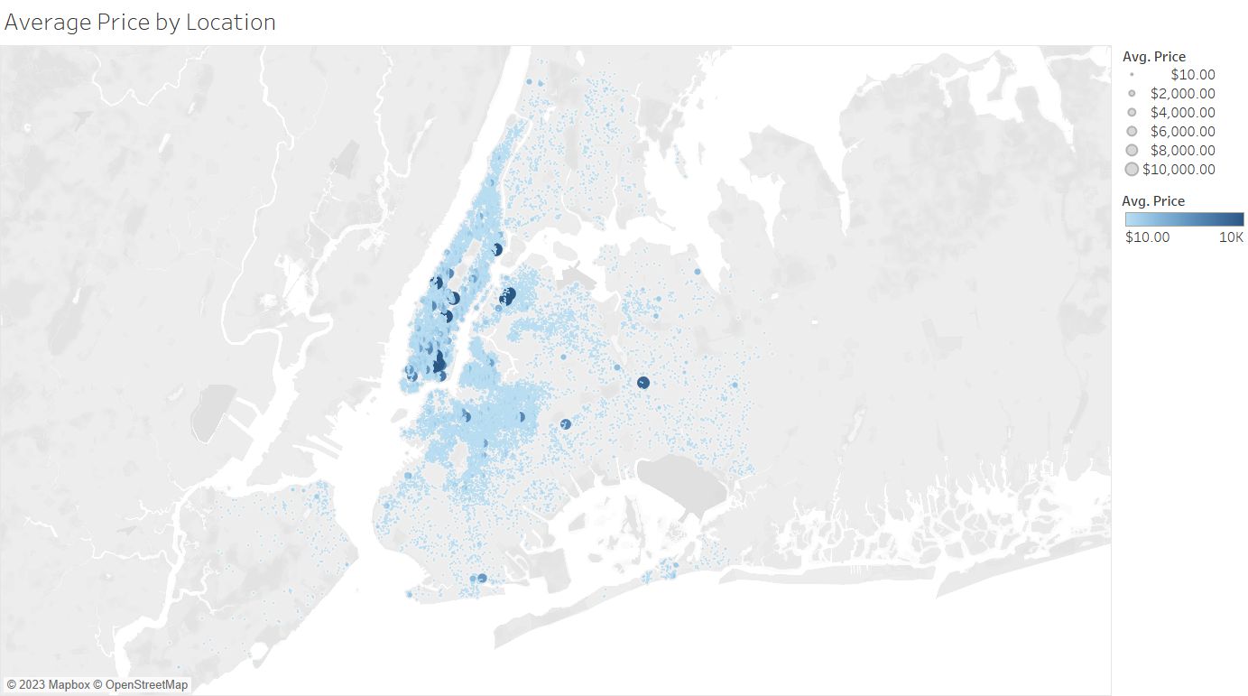
EDA: Visualization
Notes:
Here is a map with the location coordinates plotted. The dots are highly concentrated is certain areas. We sized and colored by average price because we wanted the darker blues to stand out since there were not many of them and the dots are highly concentrated.

Slide 10
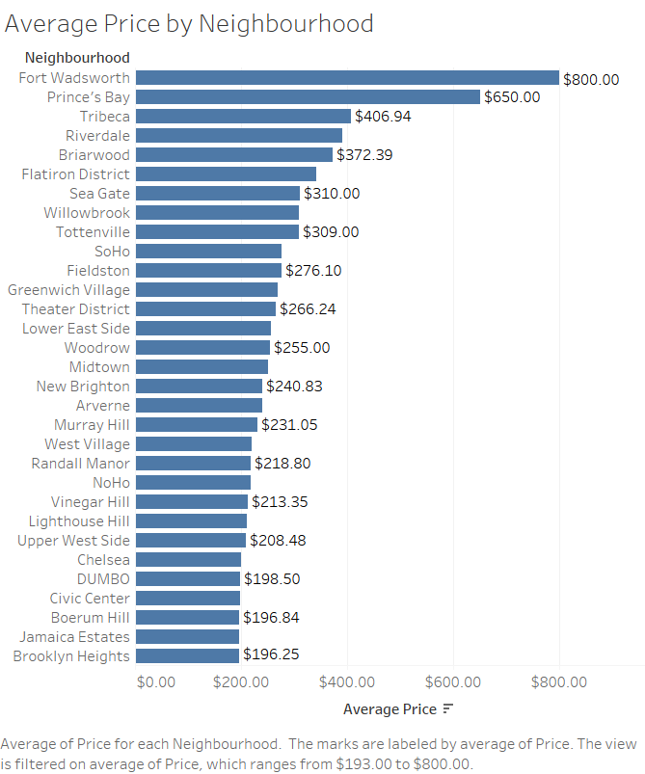
EDA: Visualization
Average Price by Neighbourhood
220 Neighbourhoods
Highest Priced: Fort Wadsworth ($800)
Lowest Priced: Gerritsen Beach ($30)
Notes:
Next we found the average price for each neighborhood. There were a total of 220 neighborhoods that have airbnb listings in New York. The neighborhood with the highest average price was Fort Wadsworth, with an average price of $800 per night. The neighborhood with the highest average price was Gerritsen Beach, with an average price of $30 per night.

Slide 11
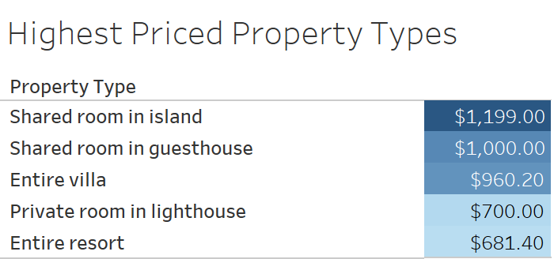
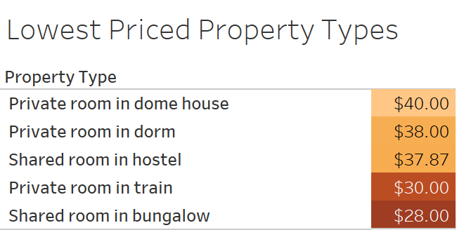
EDA: Visualization
Highest - lowest priced property types = $1,171
8 Property Types > $500
29 Property Types < $100
Notes:
Next, we investigated how property type affected average price. We found the 5 highest priced property types and the 5 lowest priced property types shown on the right. The difference between the highest priced property type, which is a shared room in island, and the lowest priced property type, which was a shared room in a bungalow, was $1,171 per night! Of the 74 property types, 8 of them were above an average of $500 per night and 29 of them were below an average of $100 per night.

Slide 12
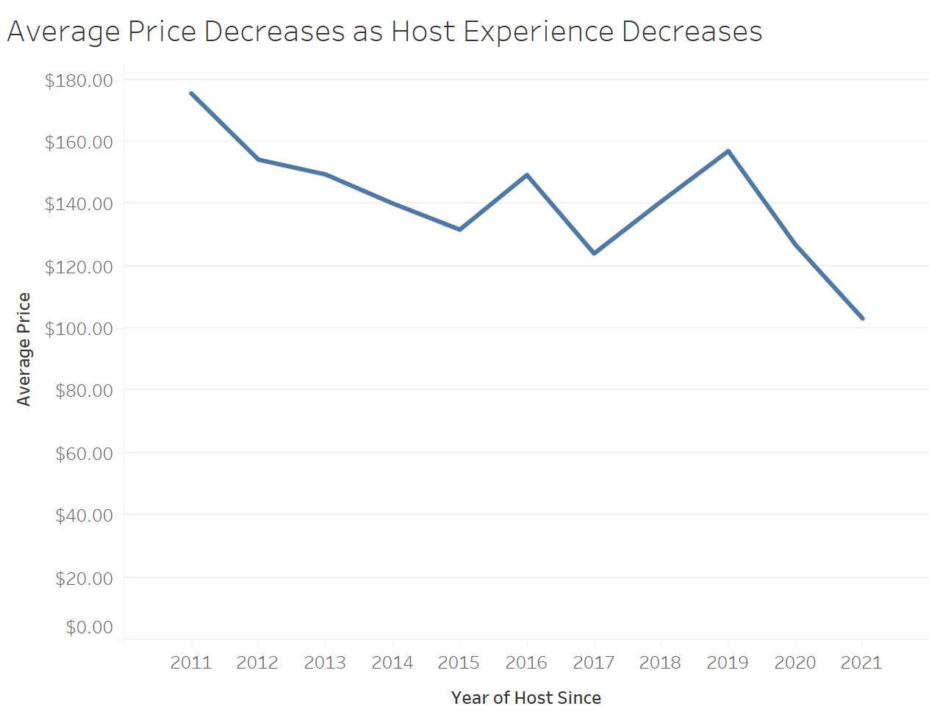
EDA: Visualization
Hosts since 2011
Average price: about $180
Hosts since 2021
Average price: about $100
Notes:
In investigating how the number of years a host has been a host since affects average price, we concluded that average price decreases as host experience decreases. As the plot shows, someone who has been a host snce 2011 has listings at an average of $180 a night while someone who has been a host since 2021 has listings at an average of $100 a night.

Slide 13
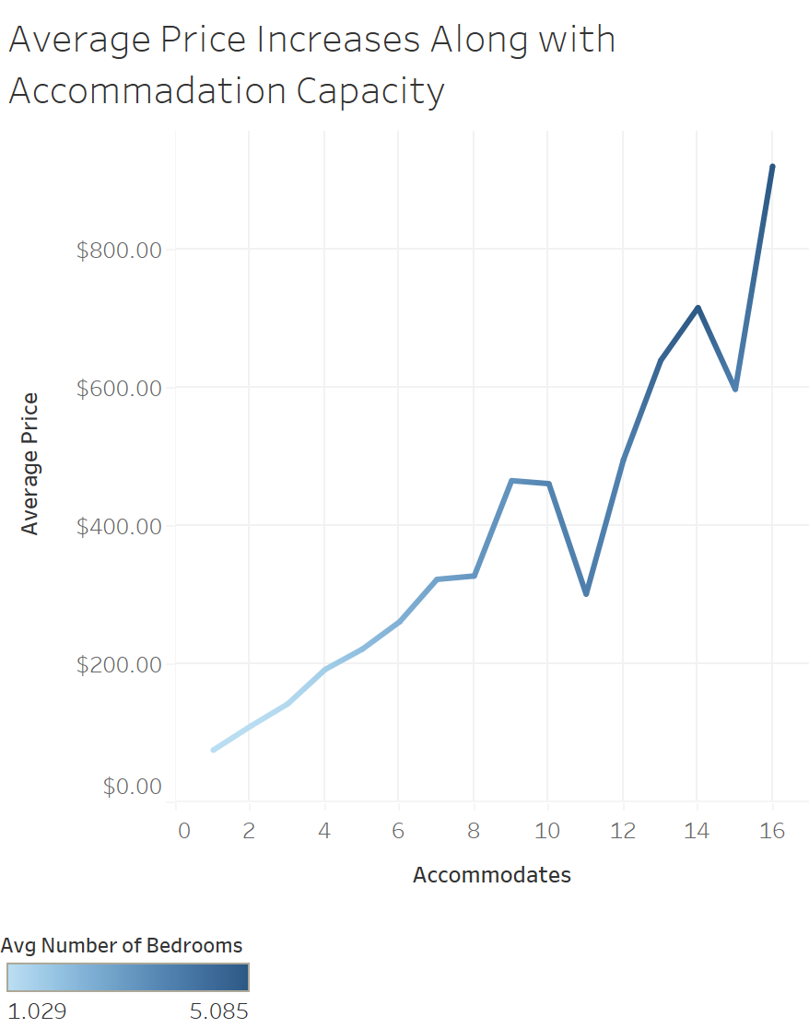
EDA: Visualization
Accommodates highly correlated with Average Price
Bedrooms highly correlated with Average Price
Notes:
We also looked at how the number of people a listing accomates and the number of bedrooms is has is correlated with average price. We see that as the number of accommates increases, the average price increases. In addition, as number of bedrooms increases, the average price increases. We also see the relationship between accommodates and bedrooms, since more bedrooms typically means the listing can accommodate more people.

Slide 14
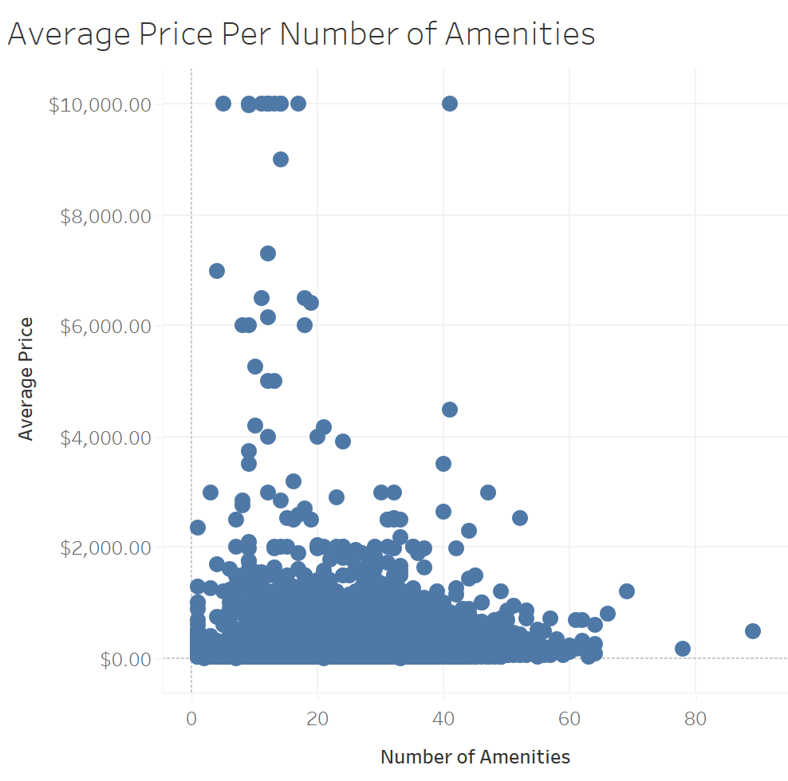
EDA: Visualization
Low correlation
Notes:
Finally, we wanted to see how the number of amenities a listing offered affected the average price. The plot of the right did not show much of a relationship between the two. We conclude that number of amenities isn’t correlated much with the average price of the property.

Slide 15
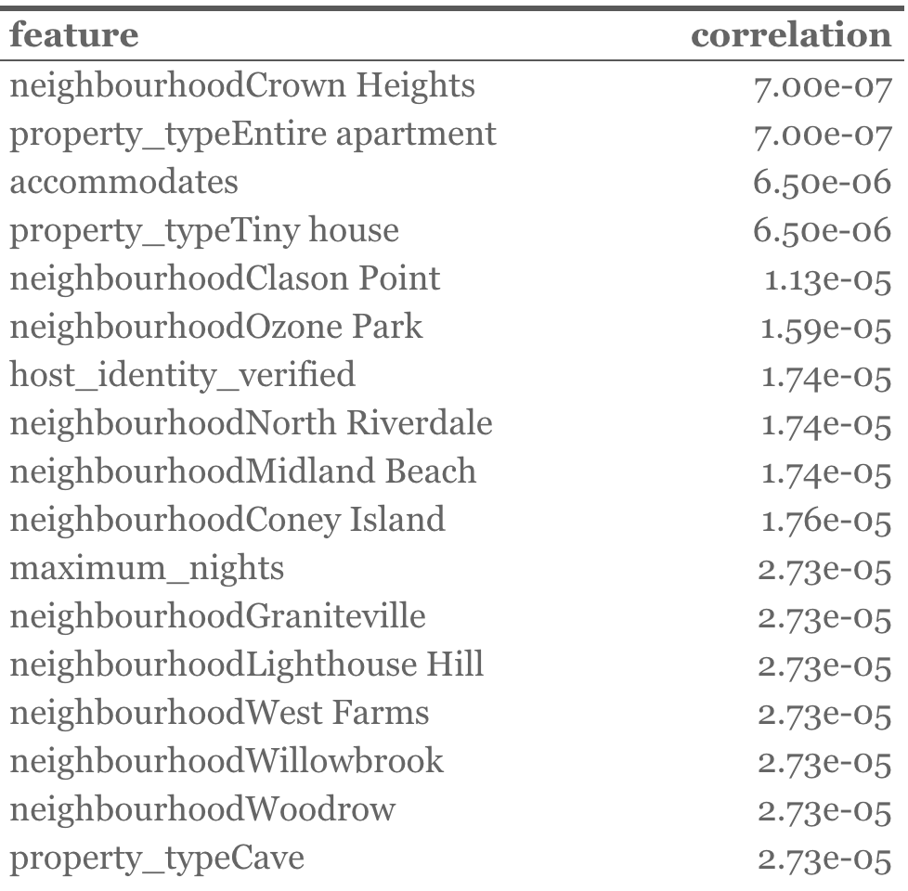
EDA: Correlation Analysis
Correlation between predictor variables
Threshold: < abs[8.05e-05]
Features Selected: 120
Preview of Results

Slide 16
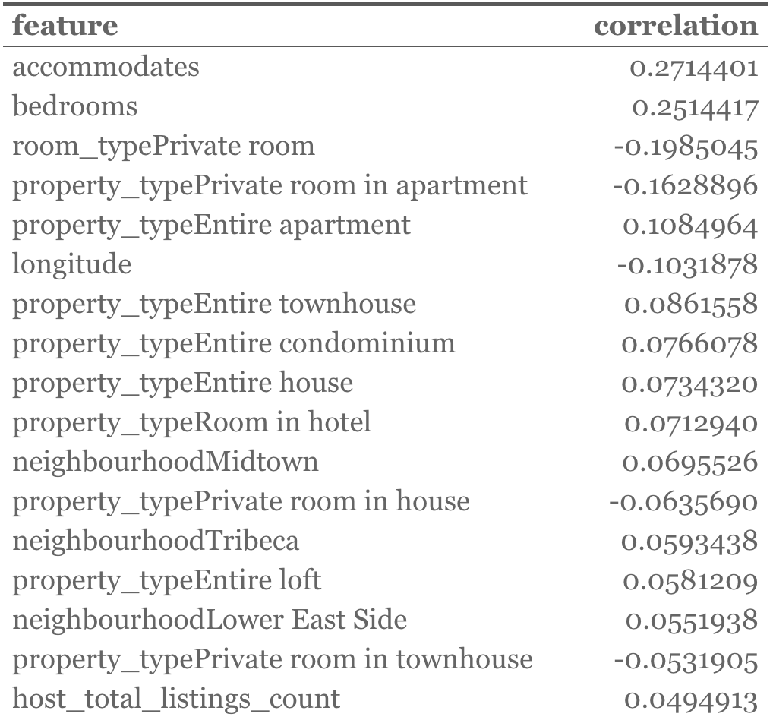
EDA: Correlation Analysis
Correlation between predictor and target (price)
Threshold: > abs[2.03e-2]
Features Selected: 50
Preview of Results

Slide 17
Modeling Approach
Data Scaling
Data Partitioning
Train
Test
Recipe Creation
Data Modeling
Linear Reg
KNN
Random Forests
Data Validation
MSE

Slide 18
Recipe 1
Correlation mix analysis
Between x variables
Between x and y variables
All significant variables
Actual Recipe:
recipe1 <- recipe(airbnb.price ~ accommodates + num_of_amenities + `property_typeRoom.in.boutique.hotel` + `property_typeEntire.villa` + `property_typeEntire.townhouse` + `neighbourhoodWest.Village` + bedrooms + `property_typeEntire.resort` + `neighbourhoodFlatbush` + `property_typePrivate.room.in.townhouse` + longitude + `neighbourhoodUpper.West.Side` , data = trainSet, importance = TRUE)

Slide 19
Recipe 2
Correlation mix analysis
Between x variables
Between x and y variables
Not all significant variables
Actual Recipe:
recipe2 <- recipe(airbnb.price ~ accommodates + num_of_amenities + `property_typePrivate.room.in.condominium` + `neighbourhoodElmhurst` + `property_typeRoom.in.boutique.hotel` + `property_typeEntire.villa` + `property_typeEntire.townhouse` + `neighbourhoodWest.Village` + `property_typeShared.room.in.apartment` + bedrooms + `property_typeEntire.resort` + `neighbourhoodFlatbush` + `property_typePrivate.room.in.townhouse` + `property_typePrivate.room.in.house` + longitude + `neighbourhoodUpper.West.Side` + `property_typeEntire.house` , data = trainSet, importance = TRUE)

Slide 20
Recipe 3
Correlation: Between x and y variables (top 30)
Not all significant variables
Actual Recipe:
recipe3 <- recipe(airbnb.price ~ accommodates + bedrooms + room_typePrivate.room + property_typePrivate.room.in.apartment + property_typeEntire.apartment + longitude + property_typeEntire.townhouse + property_typeEntire.condominium + property_typeEntire.house + property_typeRoom.in.hotel + neighbourhoodMidtown + property_typePrivate.room.in.house + neighbourhoodTribeca + property_typeEntire.loft + neighbourhoodLower.East.Side + property_typePrivate.room.in.townhouse + host_total_listings_count + neighbourhoodBushwick + num_of_amenities + neighbourhoodUpper.West.Side + neighbourhoodSoHo + property_typeEntire.serviced.apartment + neighbourhoodBedford.Stuyvesant + neighbourhoodTheater.District + neighbourhoodGreenwich.Village + property_typeRoom.in.boutique.hotel + property_typeEntire.villa + room_typeHotel.room + property_typePrivate.room.in.resort + property_typeEntire.resort + neighbourhoodWest.Village + neighbourhoodWoodside + neighbourhoodMurray.Hill + neighbourhoodFlatiron.District + neighbourhoodChelsea + neighbourhoodHell.s.Kitchen + property_typeShared.room.in.apartment , data = trainSet, importance = TRUE)

Slide 21
Data Modeling: Linear Regression
Recipe | MSE
1 | 68377.06
2 | 68395.17
3 | 66970.16
For a Linear model Recipe 3 best predicts the price of Airbnb rentals!

Slide 22
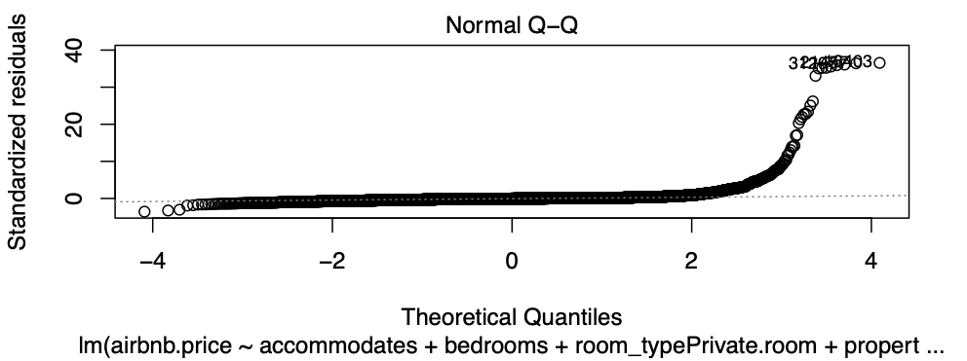
Data Modeling: Linear Regression (Q-Q Plot)
Points deviate from line
Not normally distributed
Transformation of response variable required

Slide 23
Data Modeling: KNN
Recipe | MSE
1 | 68340.48
2 | 68280.45
3 | 65727.35
For a KNN model Recipe 3 best predicts the price of Airbnb rentals!

Slide 24
Data Modeling: Random Forests
Recipe | MSE
1 | 74920.14
2 | 73262.02
3 | 65374.61
For a Random Forest model Recipe 3 best predicts the price of Airbnb rentals!

Slide 25
Data Modeling: Best Model
Model | Recipe | MSE
Linear | 3 | 66970.16
KNN | 3 | 65727.35
Random Forest | 3 | 65374.61
The Random Forest model with Recipe 3 best predicts the price of Airbnb rentals!

Slide 26
Data Modeling: Best Variables

Slide 27
Possible Shortcomings and Problems
High MSE = Bad Models
Dataset violates normality principle
Overfitting

Slide 28
Conclusion
Best Recipe: 3
Best Model: Random Forest
Best Variables
bedrooms
property_typePrivate.room.in.resort
num_of_amenities
propert_typeEntire.resort
longitude

